Slide 1
Introduction to DNS and DHCP Server Administration in CentOS
Prepared by: Guided by:
Anuja Dixit Zakir Hussian

Slide 2
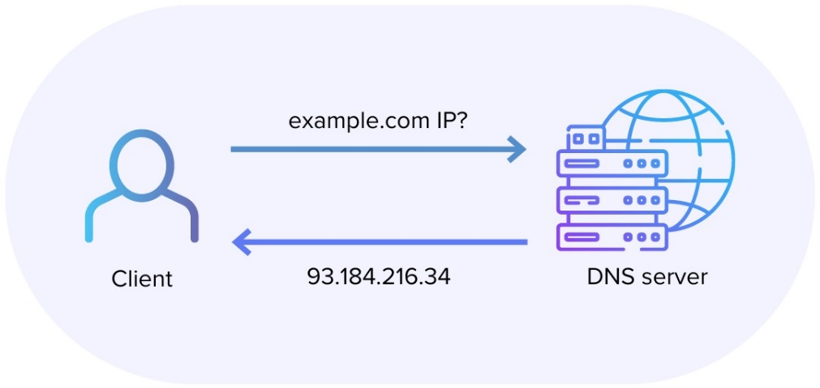
Understanding DNS: Concepts and Terminology
Domain Name System (DNS)
DNS Servers
Translates human-readable domain names to machine-readable IP addresses
Maintain a directory of domain names and their corresponding IP addresses
DNS Zones
DNS Records
Hierarchical partitions of the DNS namespace managed by individual servers
Contain information about a domain, such as IP addresses, mail servers, and more

Slide 3
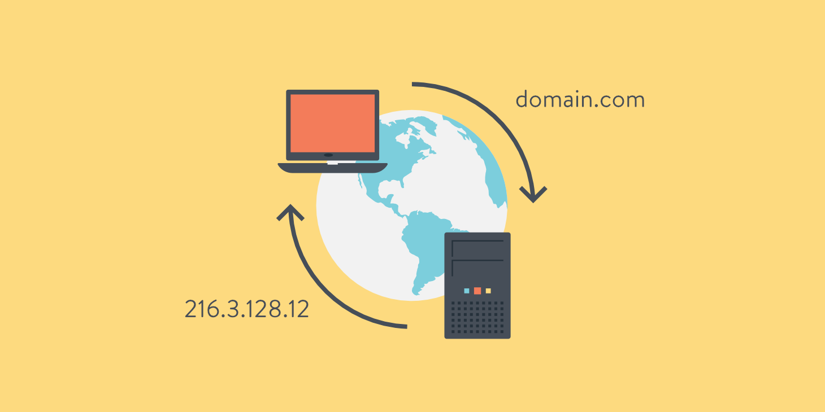
Configuring the DNS Server in CentOS
Installation
Install the DNS server package (e.g., BIND) on the CentOS system
Configuration
Set up the DNS server configuration file to define zones, IP addresses, and other settings
Testing
Verify the DNS server configuration using tools like "dig" and "host"

Slide 4
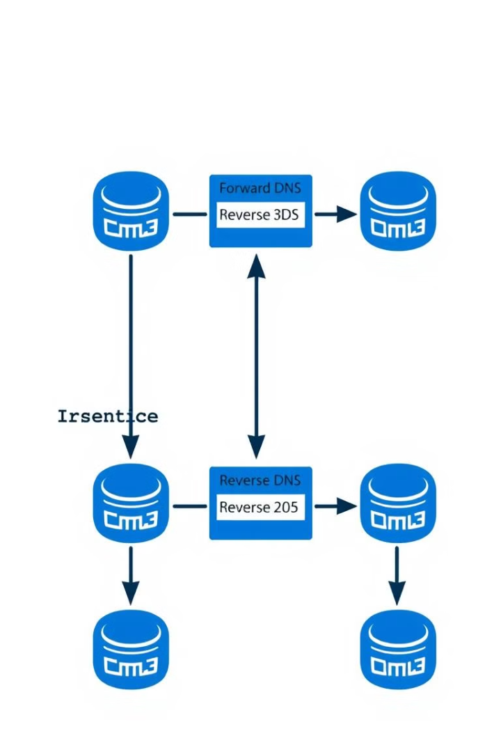
Implementing DNS Server in CentOS
1
Forward Zones
Define mapping from domain names to IP addresses
2
Reverse Zones
Define mapping from IP addresses to domain names
3
Caching and Forwarding
Improve performance and reduce load on upstream DNS servers

Slide 5
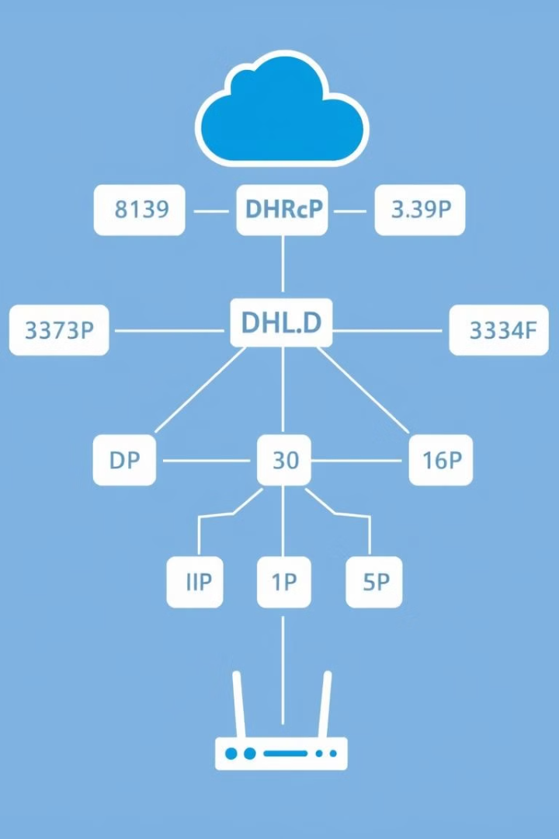
Understanding DHCP: Concepts and Terminology
Dynamic Host Configuration Protocol (DHCP)
DHCP Servers
Manage and distribute IP addresses, subnet masks, default gateways, and other network settings
Automatically assigns IP addresses and network configuration to devices on a network
DHCP Clients
DHCP Lease
Devices that request and receive network configuration information from the DHCP server
The temporary assignment of an IP address to a DHCP client for a specified duration

Slide 6




Implementing DHCP Server in CentOS
Install DHCP Server
Install the DHCP server package (e.g., dhcpd) on the CentOS system
Configure DHCP Server
Set up the DHCP server configuration file to define network settings and IP address ranges
Start DHCP Service
Enable and start the DHCP server service to begin serving IP addresses to clients

Slide 7
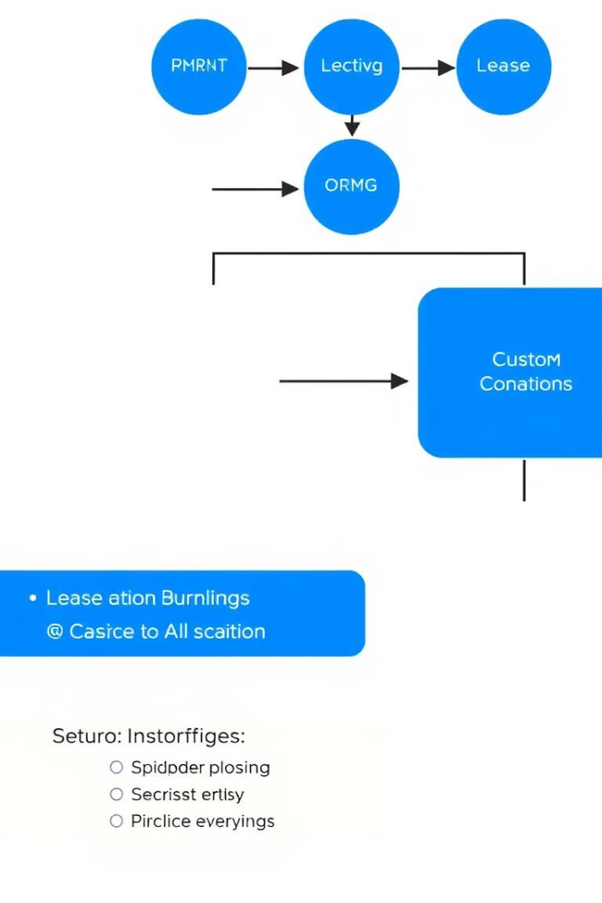




Configuring DHCP Server Options
Network Settings
Lease Duration
Configure subnet masks, default gateways, and DNS servers
Set the duration for which an IP address is assigned to a client
Custom Options
Security
Define additional network configuration options for DHCP clients
Implement DHCP server authentication and access control measures

Slide 8

Troubleshooting DNS and DHCP Server Issues
Symptom
Potential Cause
Troubleshooting Steps
Clients unable to resolve domain names
Incorrect DNS server configuration
Check DNS server settings, zone files, and firewall rules
Clients not receiving IP addresses from DHCP
DHCP server misconfiguration
Verify DHCP server settings, IP address pools, and network connectivity
Slow DNS or DHCP server performance
Resource constraints or excessive load
Monitor server resources, optimize configuration, and scale as needed

Slide 9
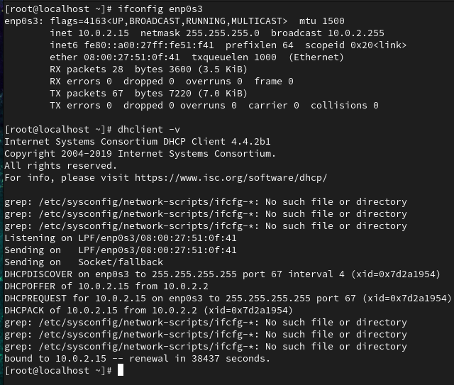
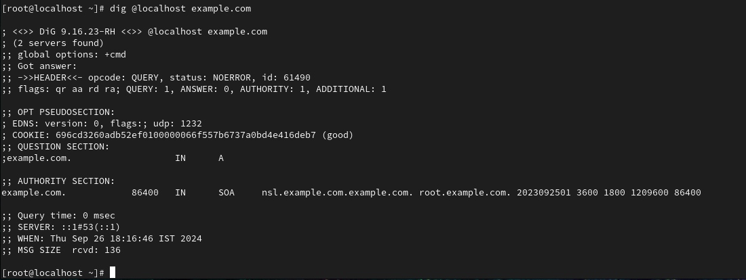
Project
Problem Statement of the project:
The network administrator at ABCD Marketing Company needs to design and implement a centralized solution for managing IP addresses and ensuring efficient domain name resolution for internal services and devices. The solution must be scalable, secure, and easy to manage, with the ability to integrate with existing network infrastructure.

Slide 10
Thank you

